Slide 1
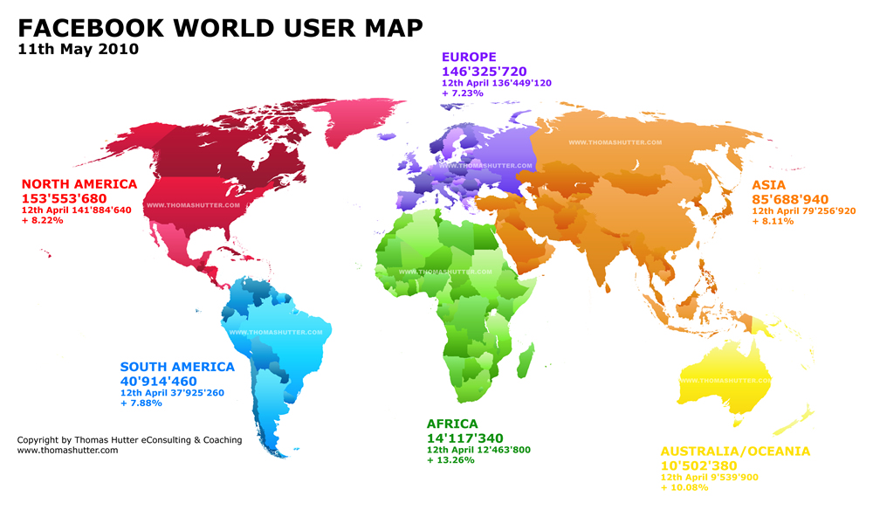

Slide 2
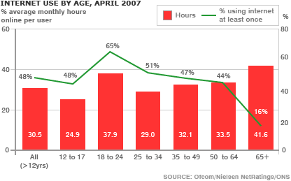

Slide 3
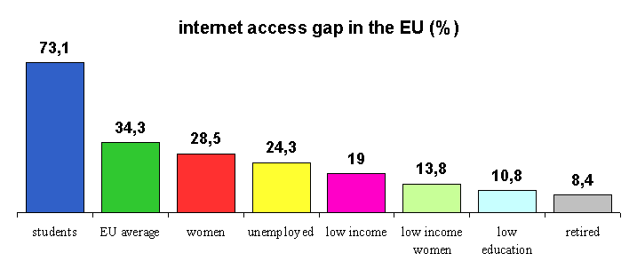
Eurobarometer of the European Commission ,2001

Slide 4
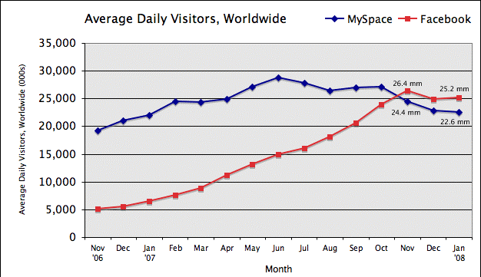
Kafka,P. (2008).Facebook about to pass Myspace in worldwide traffic. Retrieved 5th may, 2011 from www.businessinsider.com

Slide 5
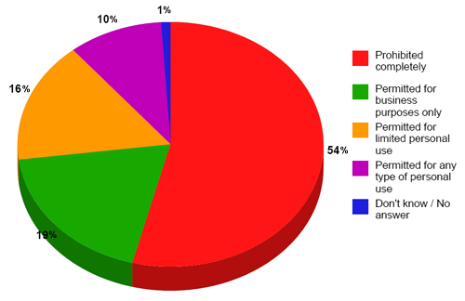
The approach of U.S. workplaces to their employees’ use of Social Media at work
Robert Half Technology, 2009

Slide 6
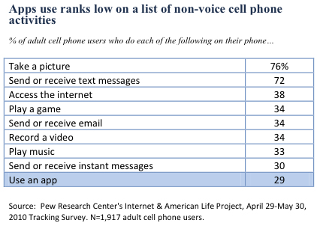

Slide 7
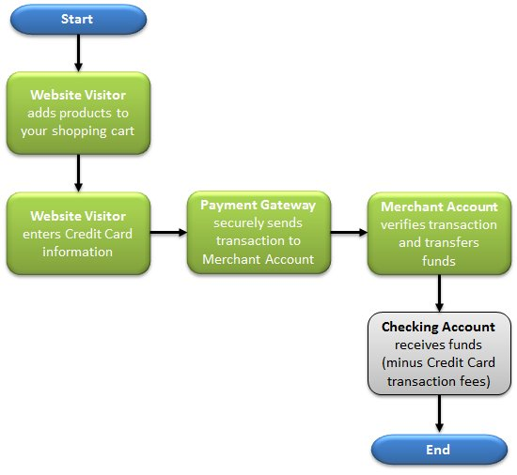
Online Shopping-STEPS

